Slide 1
Determining the Relation Between Mental/Physical Health and Chronic Diseases
Vishal Singarapu
Kranthi Chaitanya Thota Syed Junaid Mohiuddin

Slide 2
Introduction
In this project, we explore the relationship between mental/physical health and various chronic diseases using data from the year 2022. The analysis includes data cleaning, preprocessing, statistical tests, and visualizations.
Objective
To determine the relationship between mental/physical health indicators and chronic diseases such as diabetes, arthritis, lung disease, kidney disease, heart disease, and depression.

Slide 3
DataSource & Variables
The dataset used in this analysis is the 2022 annual data consisting of 445,132 rows and 328 columns.
We selected these 22 columns as they were most relevant ones from the dataset.
Out of these 22 columns only 2 columns (Height and Weight) are continuous and the rest of them are categorical variables.
Key variables:
Source:Behavioral Risk Factor Surveillance System 2022 Data
Health Status | Physical Health | Mental Health | Exercise | Heart Disease | Height
Weight | BMI | Income | Smoking | Alcohol Consumption | Decisions
Depressed | Arthritis | Lung Disease | Kidney Disease | Diabetes | Asthma
Education | General Health | Age | Sex

Slide 4
Data Analysis (Data Pre-processing)
Data cleaning and preprocessing steps involved:
Handling missing values
Encoding categorical variables
Normalizing/standardizing numerical variables

Slide 5
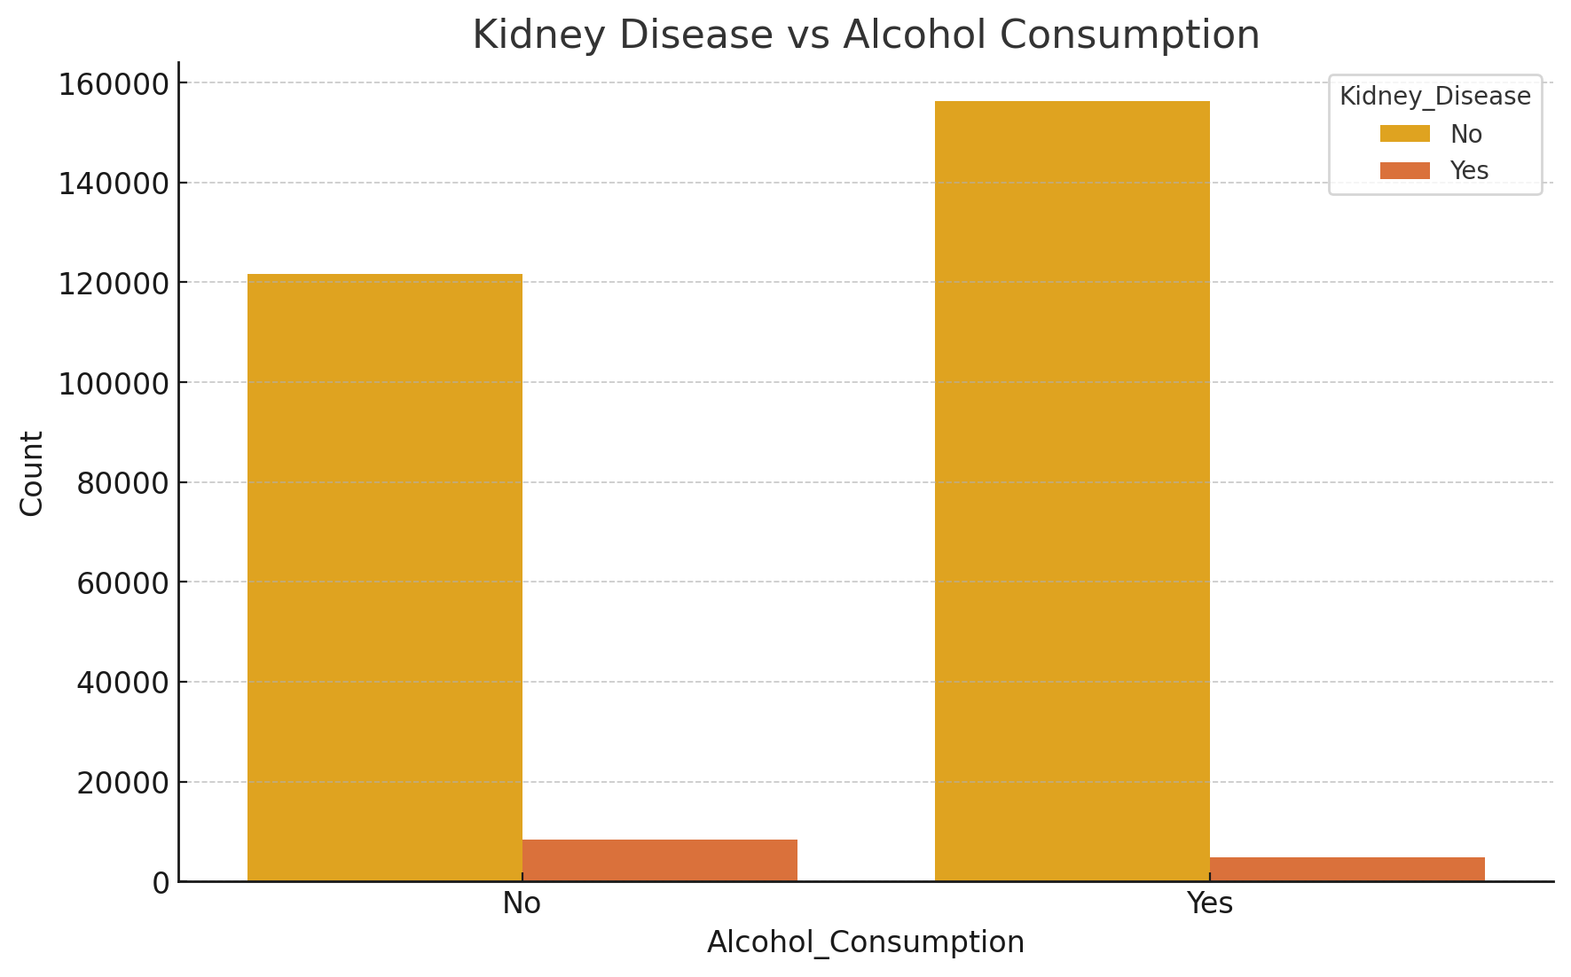
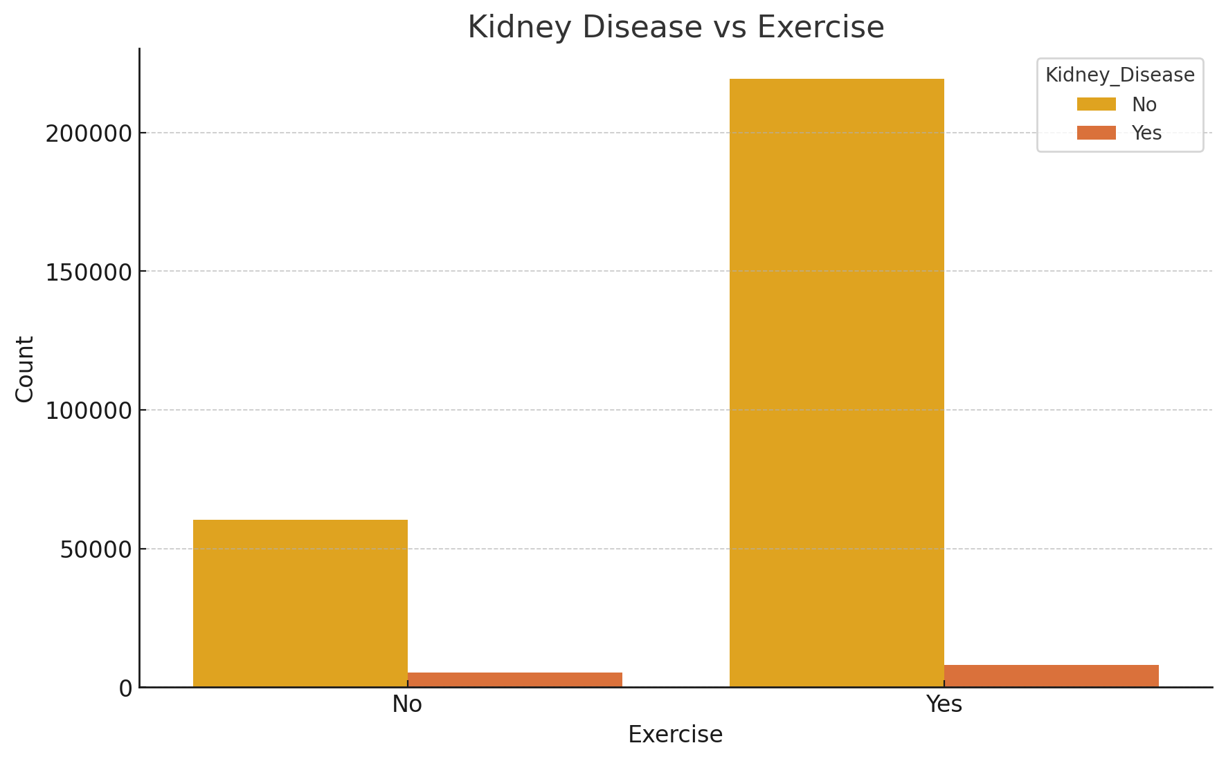
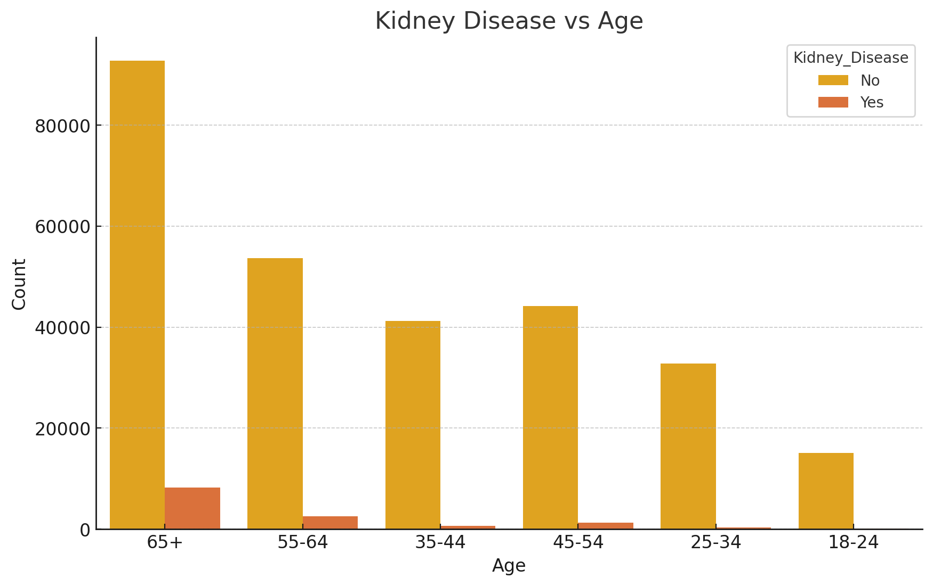
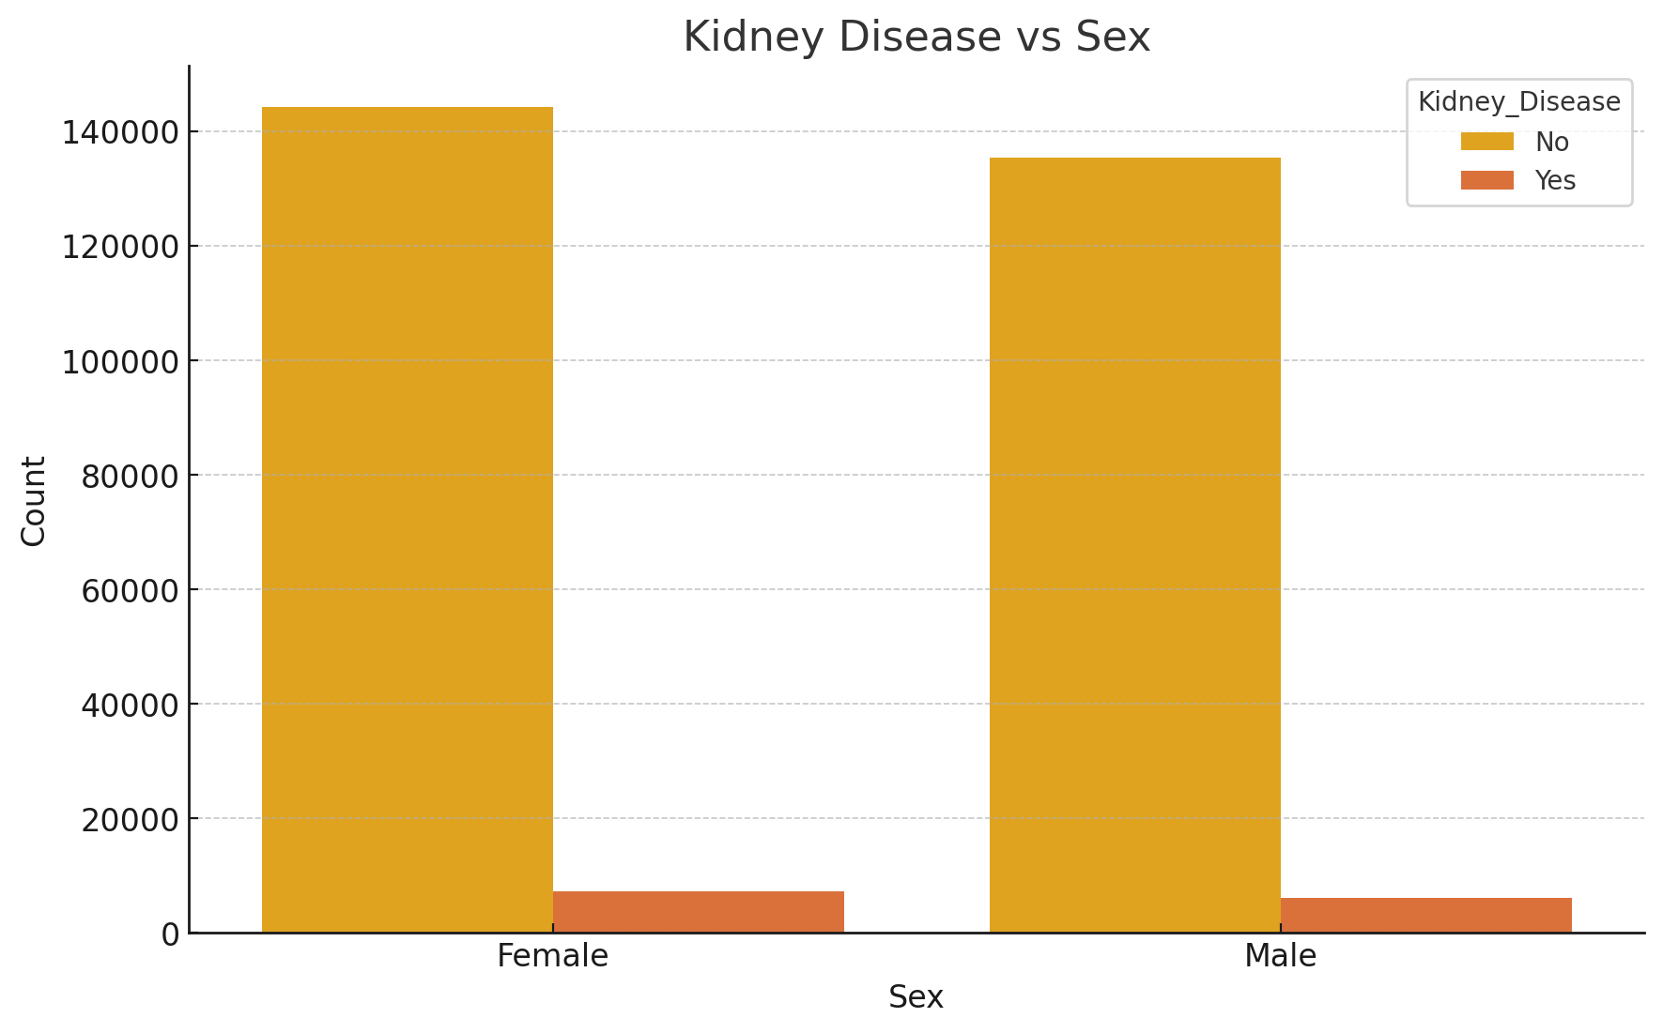
Data Visualisations

Slide 6
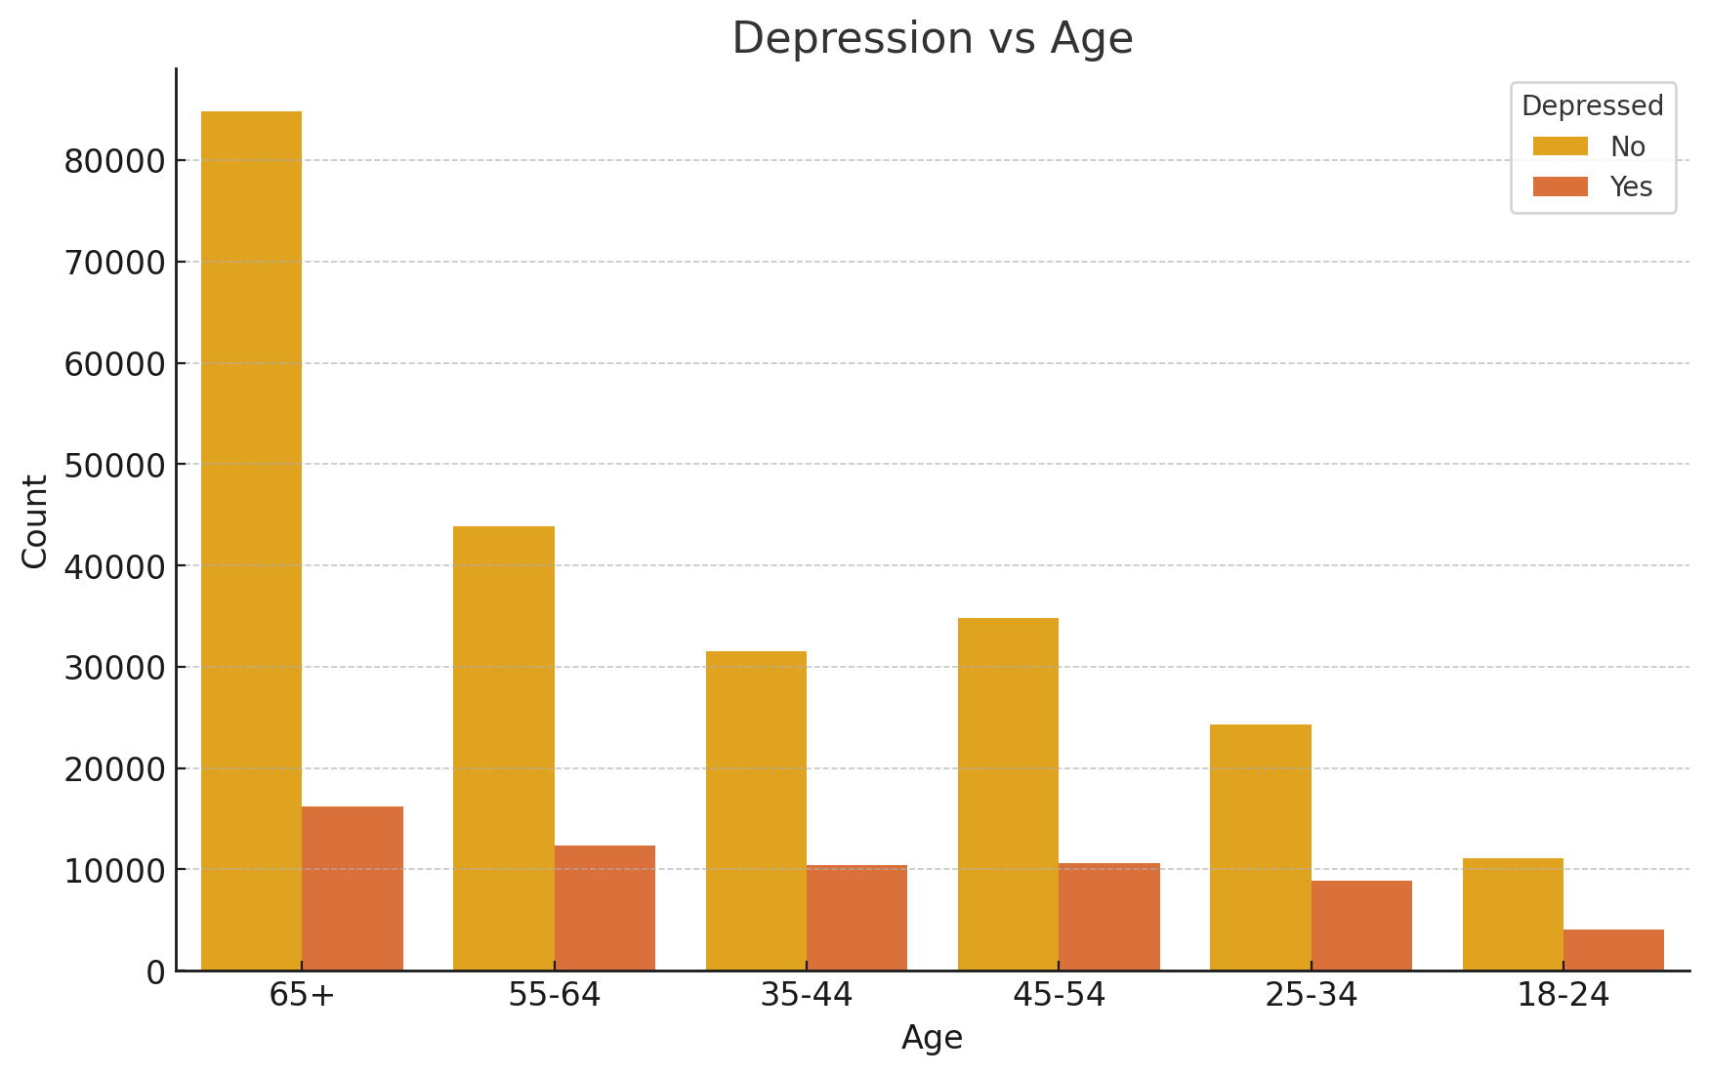
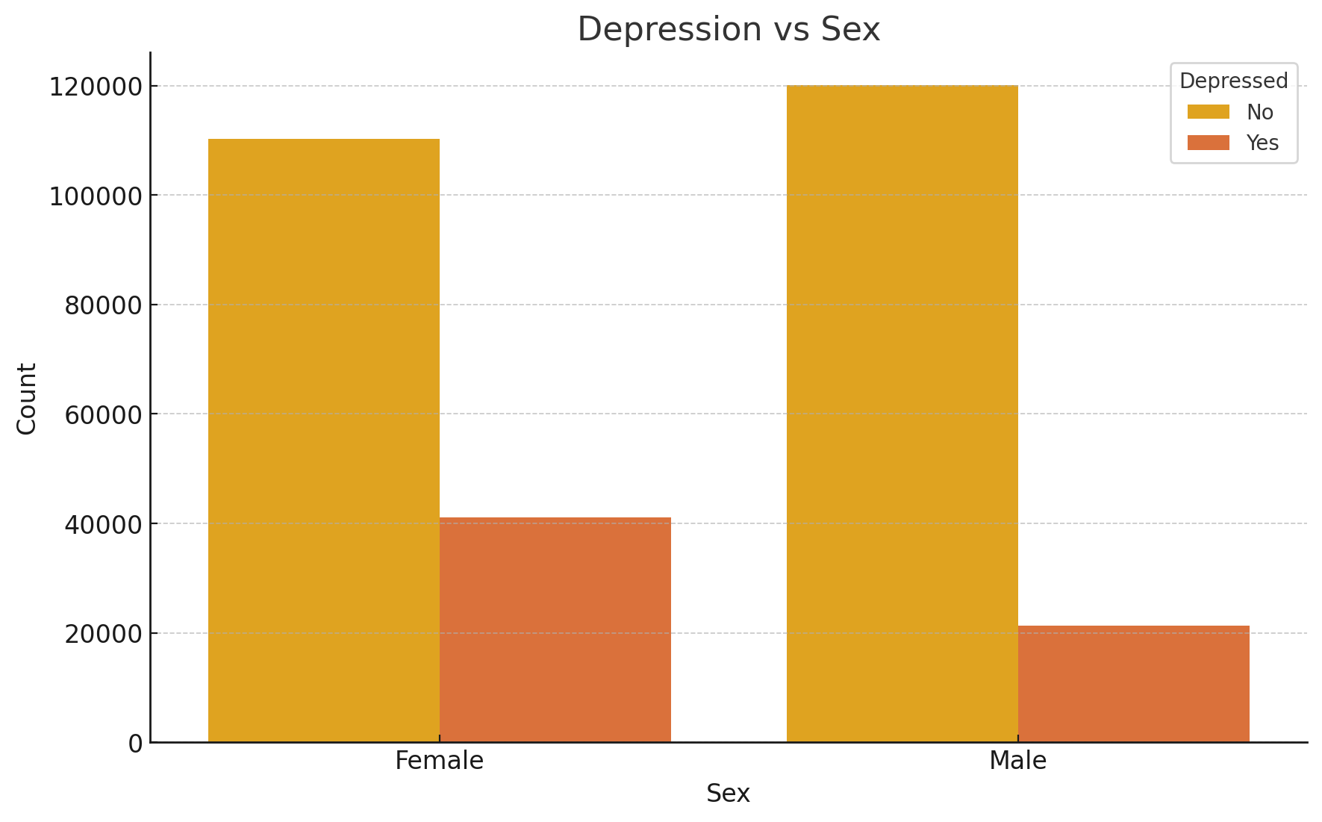
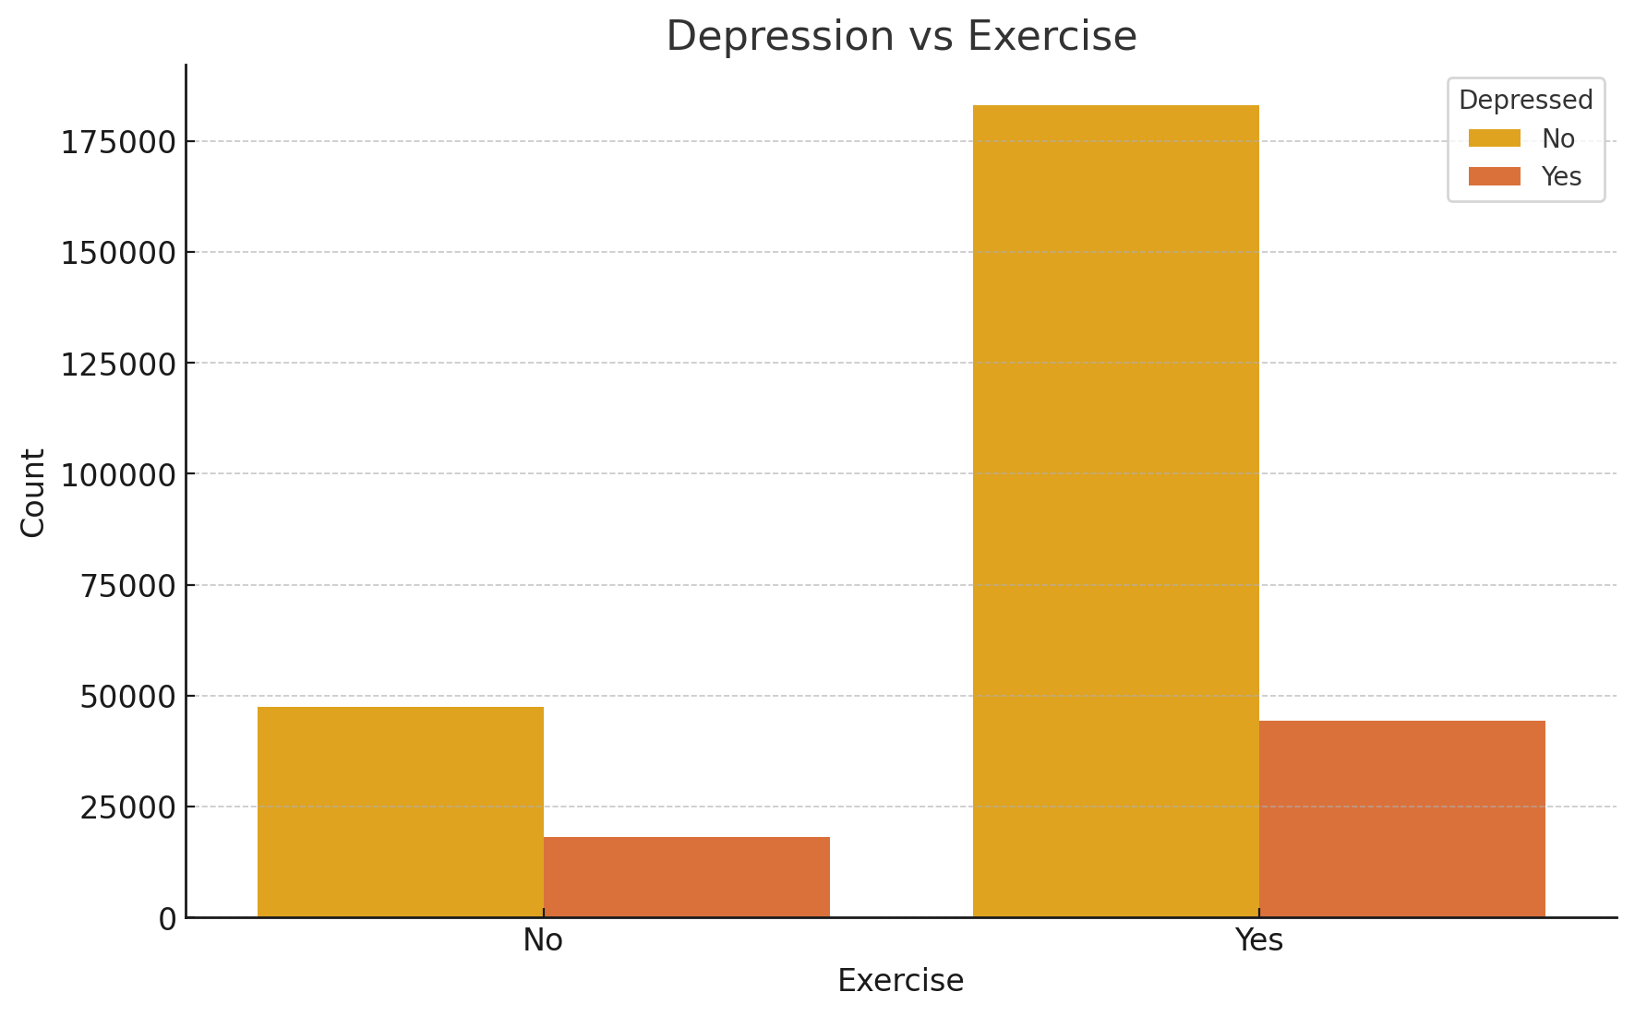
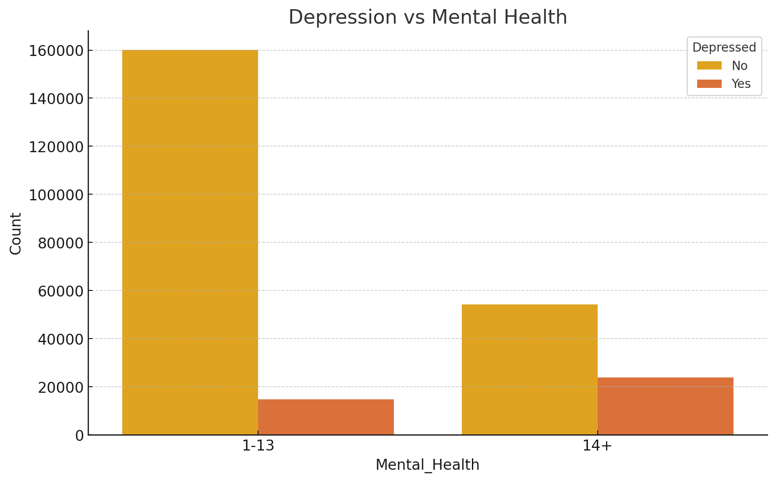

Slide 7
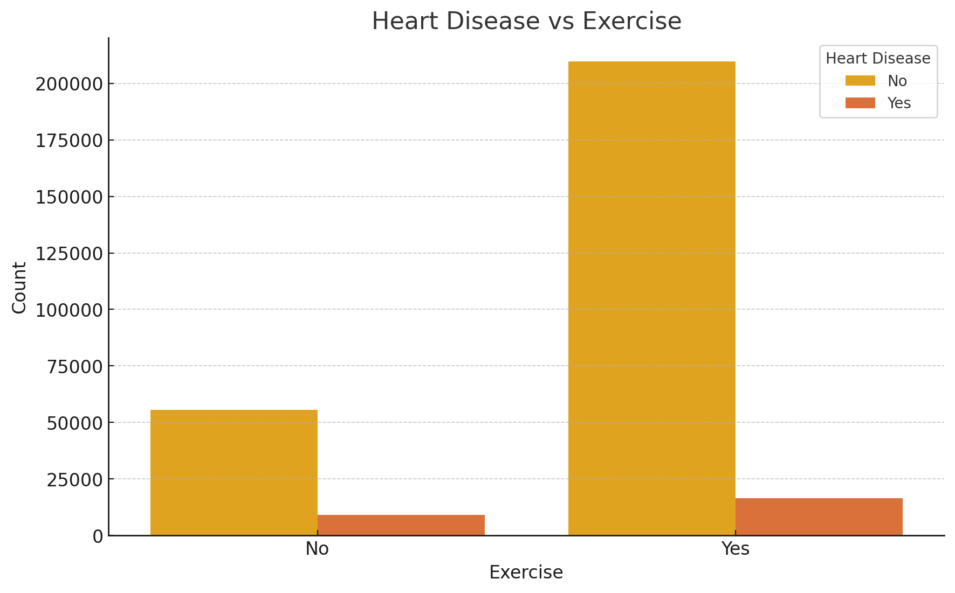
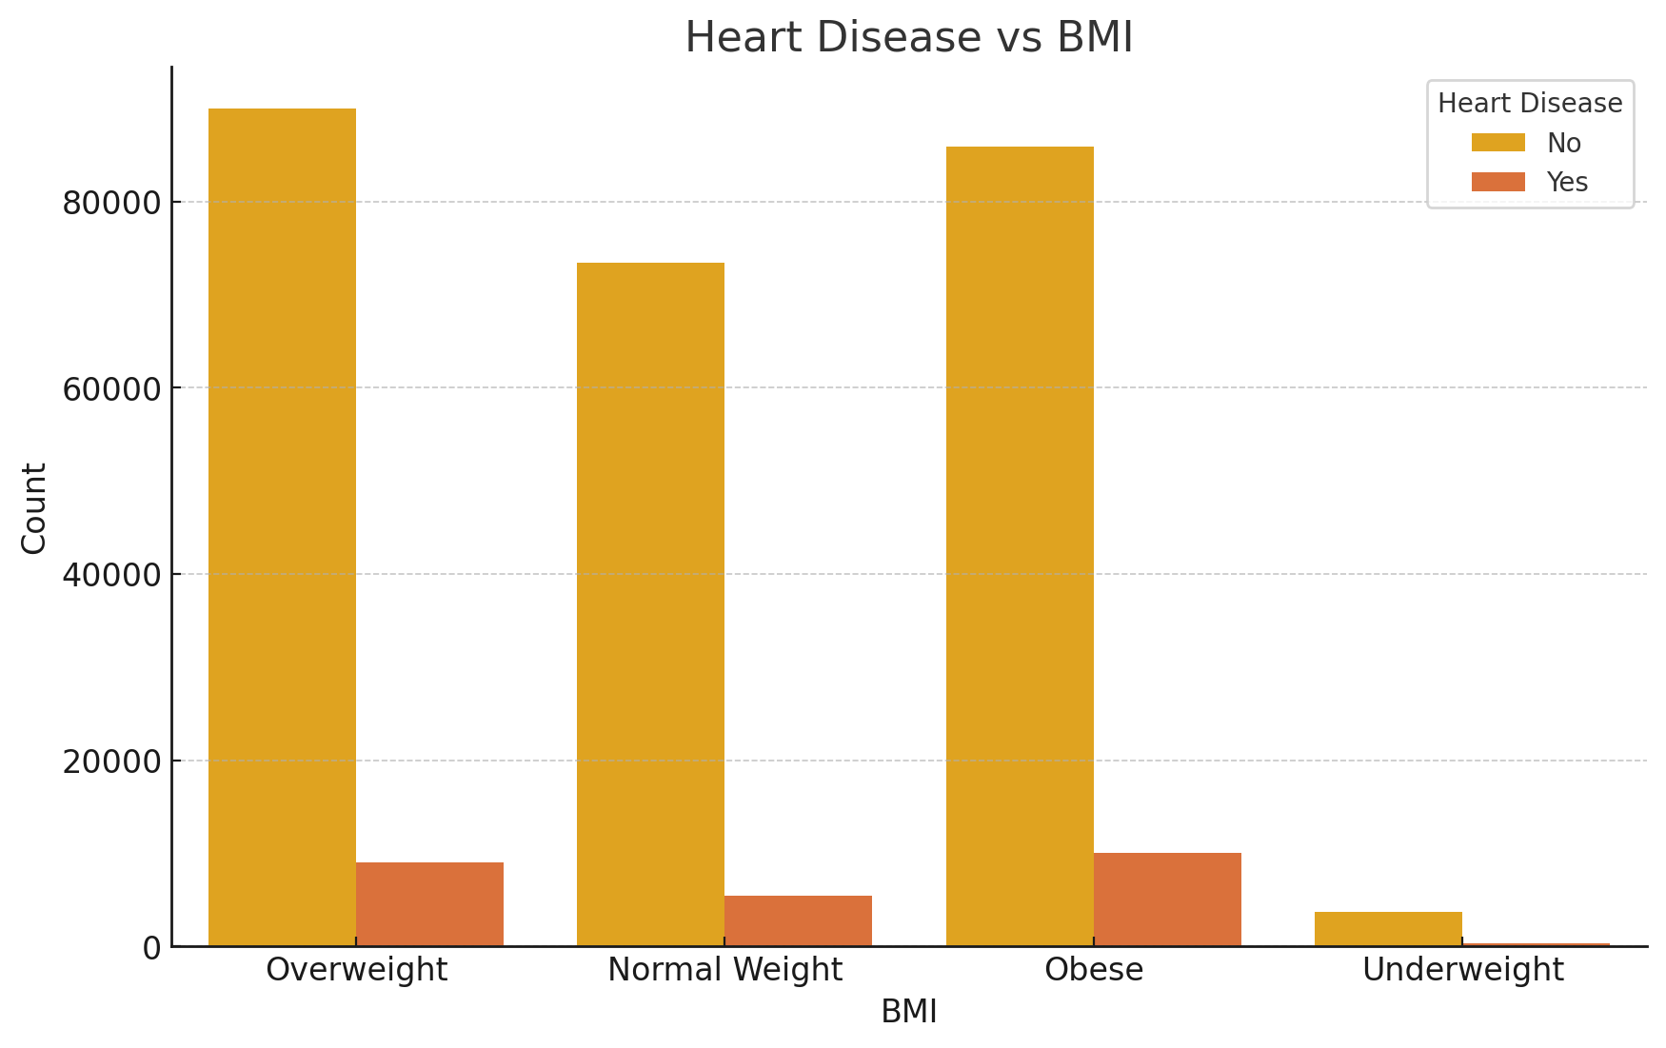
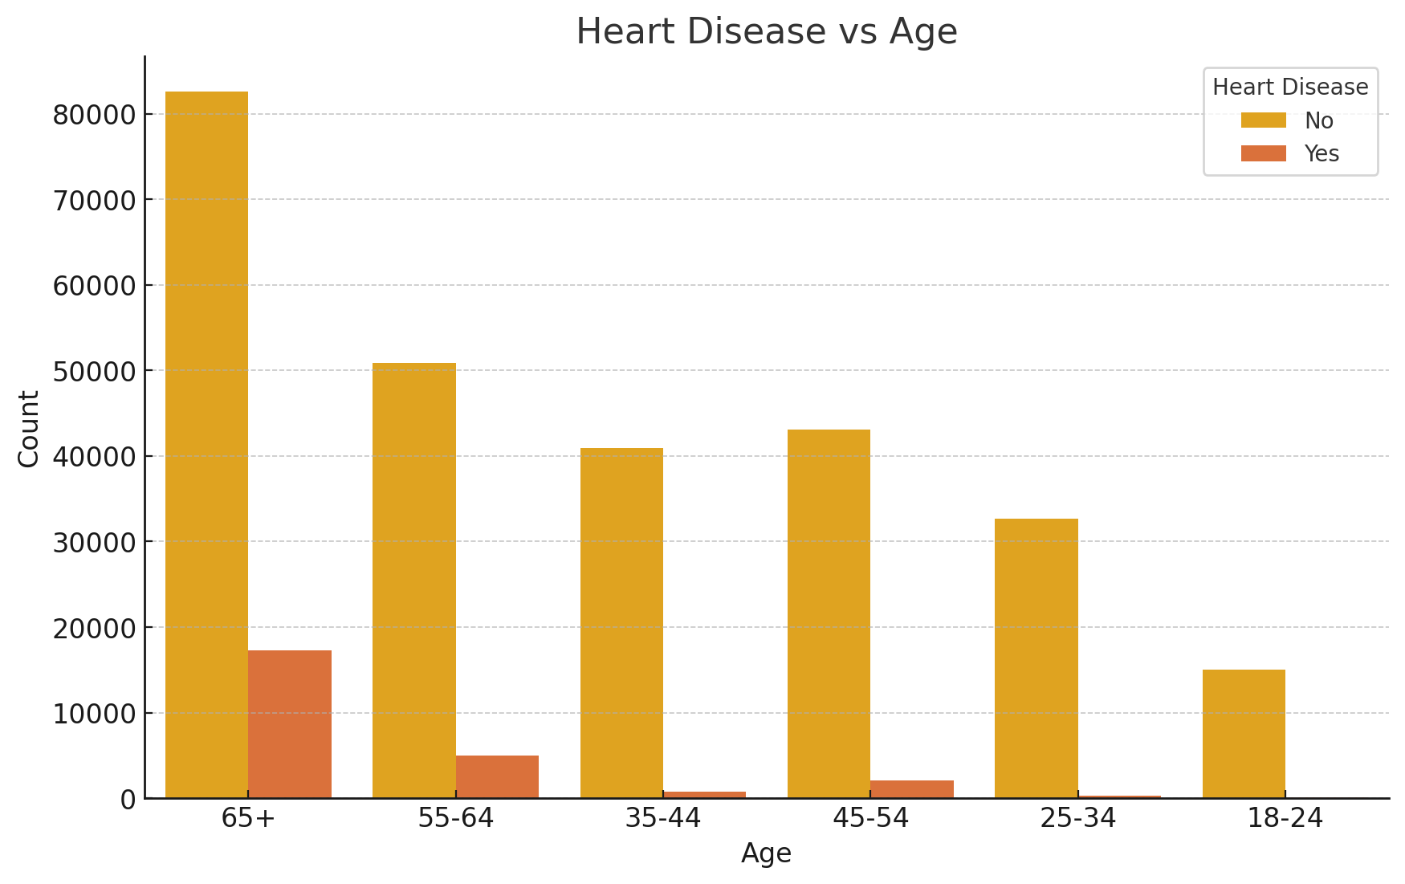

Slide 8
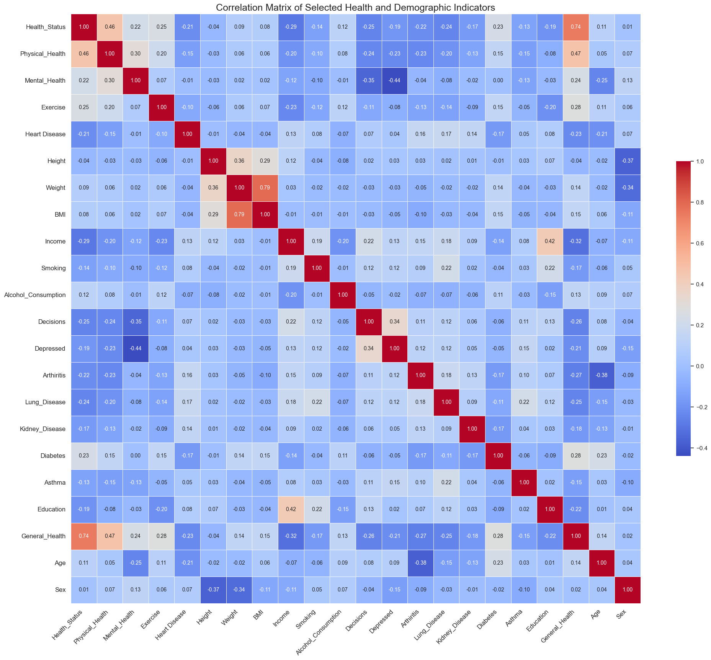
Correlation Matrix
Correlation
Plot

Slide 9
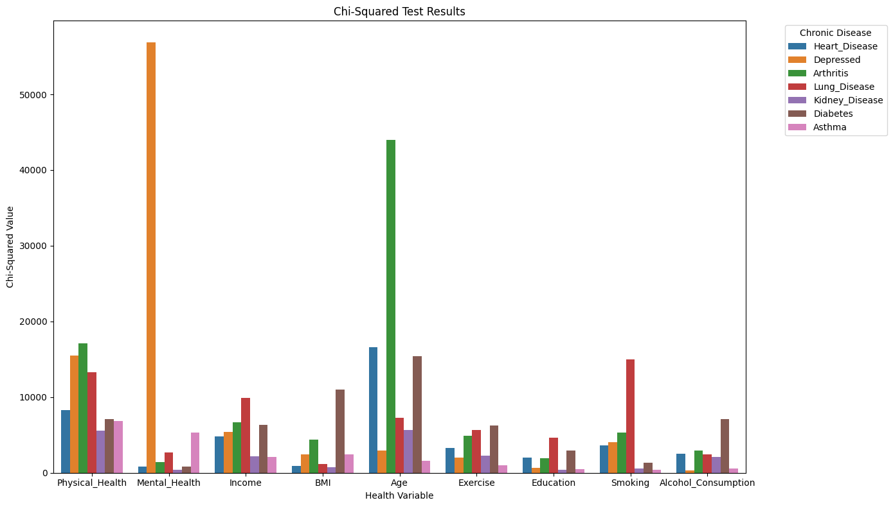
Chi Squared test results

Slide 10
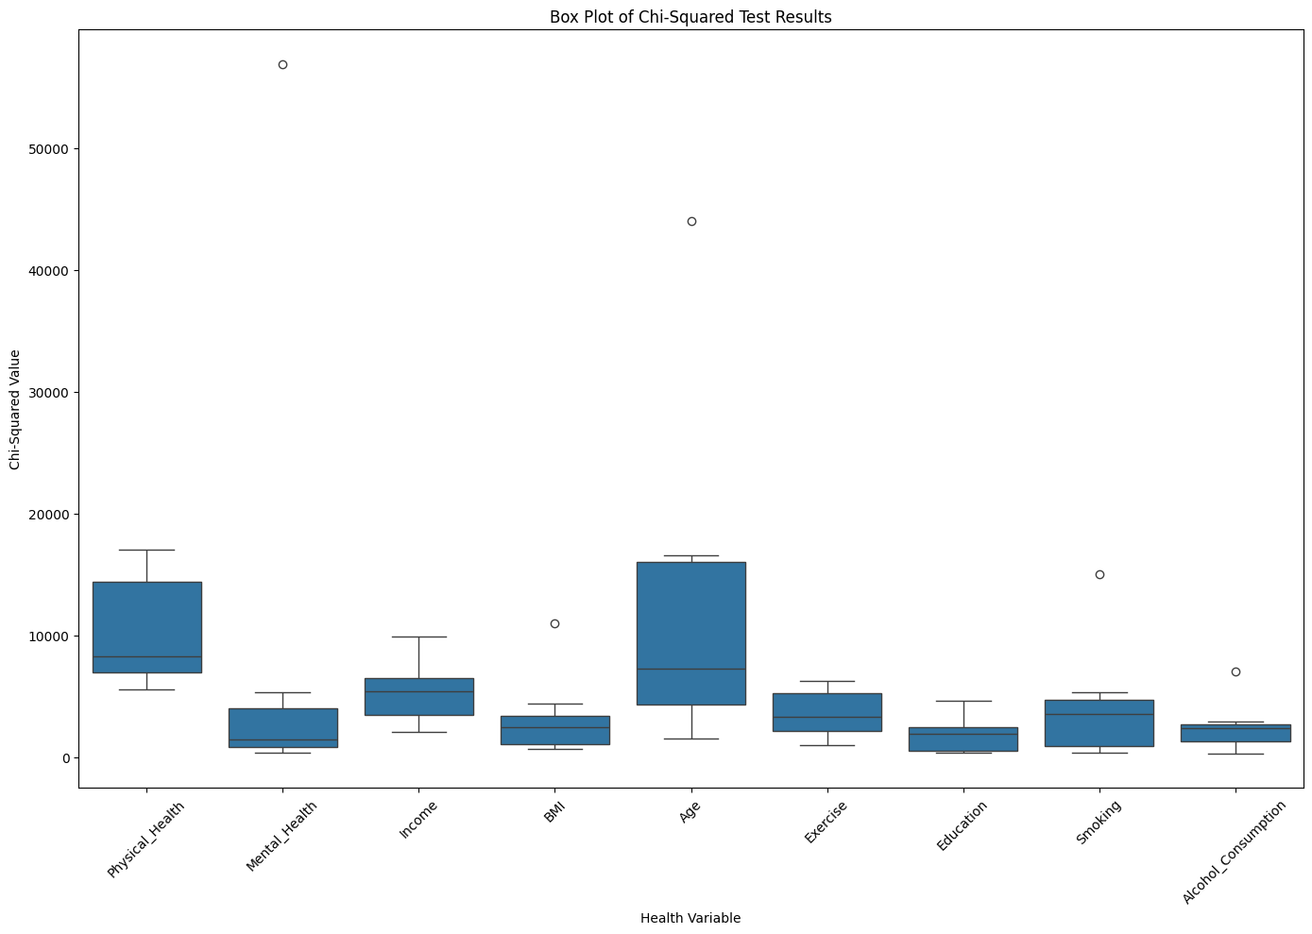

Slide 11
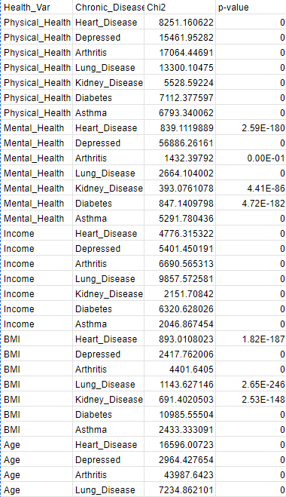
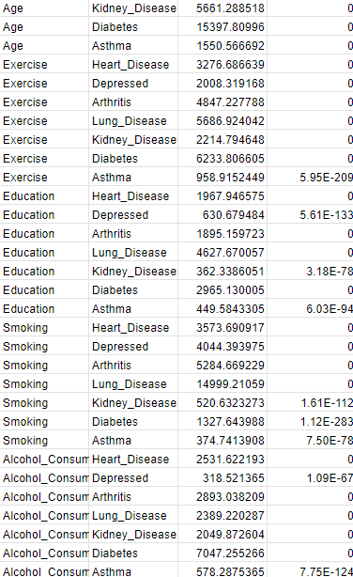
Chi Squared test results

Slide 12
Chi-Square Test
Chi-Square test was applied to determine the associations between categorical variables. The results indicate significant relationships between the variables of interest.
Equal Significance:
Every examined variable (Physical Health, Mental Health, Exercise, Education, Smoking, Income, BMI, Age, and Alcohol Consumption) has statistically significant associations with chronic diseases.
Strong Associations:
Physical Health shows particularly strong associations with Depression (Chi2 = 15461.95) and Arthritis (Chi2 = 17064.45).
Mental Health has an extremely strong association with Depression (Chi2 = 56886.26).
Exercise is strongly associated with Arthritis (Chi2 = 4847.23) and Lung Disease (Chi2 = 5686.92).
Age has an exceptionally strong association with Arthritis (Chi2 = 43987.64).
Implications:
The strong associations between specific health behaviors and chronic diseases emphasize the need for targeted health interventions.
These findings can guide health policy and personalized health strategies to mitigate the risk of chronic diseases based on the significant variables identified.

Slide 13
Observations:
Strong correlation between physical health and the prevalence of chronic diseases.
Mental health indicators also show significant relationships with certain chronic diseases.
Conclusion:
The analysis provides insights into how mental and physical health are interrelated with chronic diseases. These findings can be used to inform public health policies and interventions.

Slide 14
Future Scope
Creating a predictive model using ML models to predict the chronic diseases based on the symptoms and lifestyle.
Making a time series analysis.
Making a analysis on what kind of diseases are more prevalent in different community sectors.
Quality of life analysis.

Slide 15
Acknowledgment
Special Thanks
Prof. Sumona Mondal
Naveen Ramachandra Reddy

